Slide 1
IOT Based Smart ICU Patient Monitoring System
Dandla Saikumar
IBM Certified DS&AI Professional, Software Engineer
Infor India

Slide 2
CONTENTS:
Introduction
Aim of the project
Objectives of the project
Circuit Diagram
Hardware Description
Configuring ThingSpeak to record Patient Data online
Configuring IFTTT for triggering Mail/SMS based on ThingSpeak Values
Patient Monitoring System in Action
Results
Future Work

Slide 3
Introduction:
In this project, we will make an IOT based Smart ICU Patient Monitoring System which records the patient heart beat rate and body temperature
send an email/SMS alert whenever those readings goes beyond critical values.
Pulse rate and body temperature readings are recorded over ThingSpeak
Google sheets so that patient health can be monitored from anywhere in the world over internet.
A panic will also be attached so that patient can press it on emergency to send email/sms to respective persons and their relatives.

Slide 4
Aim:
Health monitoring is the major problem in today’s world. Due to lack of proper health monitoring, patient suffer from serious health issues.
To Solve this problem , There are lots of IOT devices now days to monitor the health of patient over internet.

Slide 5
Objectives:
To understand the salient features, architecture and pin configuration of the Arduino UNO R3 board.
To learn the Arduino IDE software tool for Arduino.
To learn an Embedded C to write code for Arduino board.
To interface the Pulse Rate Sensor and LM35 Temperature Sensor to the Arduino
Connect with Thinkspeak and IFTTT

Slide 6
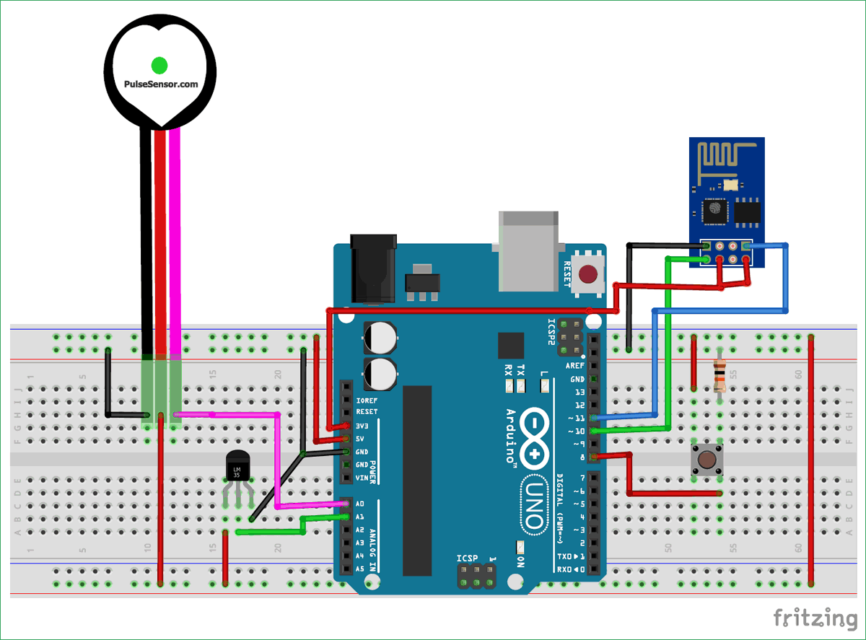
Circuit Diagram:

Slide 7
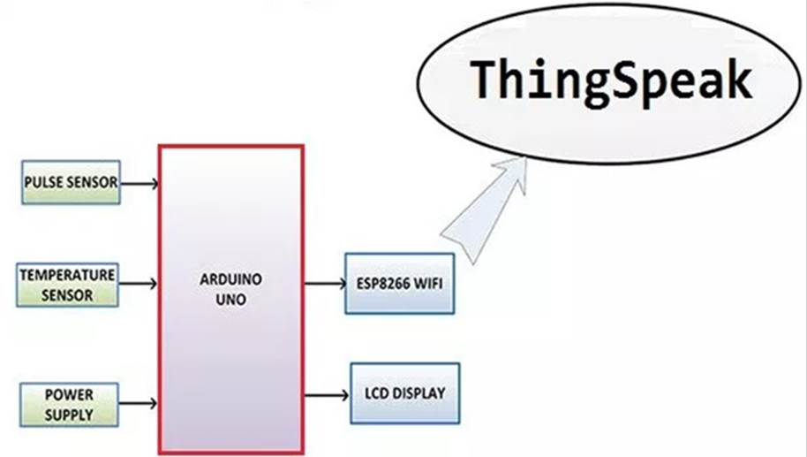
Block Diagram:

Slide 8
Hardware Component's:
Arduino Uno
Arduino Cable
ESP8266 Wi-Fi Module
LM35 Temperature Sensor
Pulse Rate Sensor
Push Button
10k Resistor
Male-Female Wires
Bread Board

Slide 9
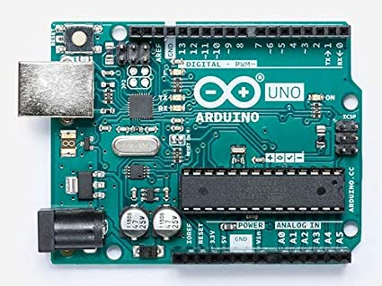
Arduino Uno:
open-source microcontroller board based on the Microchip ATmega328P microcontroller and developed by Arduino.cc
Equipped with sets of digital and analog input/output (I/O) pins that may be interfaced to various expansion boards (shields) and other circuits

Slide 10
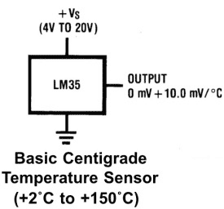
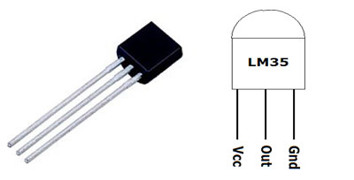
LM35 Temperature Sensor:
LM35 is a analog linear temperature sensor. Its output is proportional to the temperature (in degree Celsius).
The operating temperature range is from -55°C to 150°C.
The output voltage varies by 10mV in response to every ºC rise or fall in temperature. It can be operated from a 5V as well as 3.3 V supply and the stand by current is less than 60uA.

Slide 11
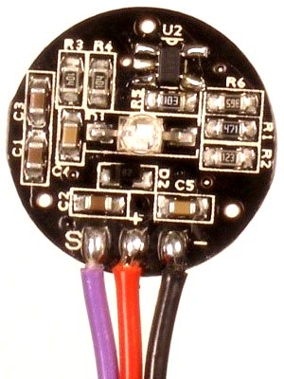
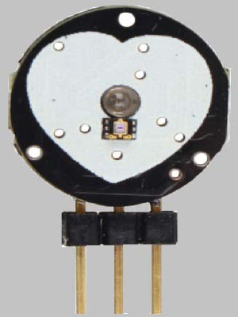
Pulse Rate Sensor:
Pulse Sensor is a well-designed plug-and-play heart-rate sensor for Arduino.
Biometric Pulse Rate or Heart Rate detecting sensor
Plug and Play type sensor
Operating Voltage: +5V or +3.3V
Current Consumption: 4mA
Inbuilt Amplification and Noise cancellation circuit.

Slide 12
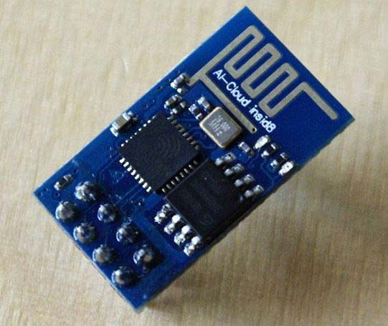
ESP8266 WiFi:
A cost-effective and highly integrated Wi-Fi MCU for IoT applications
This microcontroller has the ability to perform WIFI related activities hence it is widely used as a WIFI module.
The module can work both as a Access point (can create hotspot) and as a station (can connect to Wi-Fi), hence it can easily fetch data and upload it to the internet making Internet of Things as easy as possible

Slide 13

Software Specifications:
Operating System : Windows 7 or higher
Platform : ThingSpeak, IFTTT
IDE : Arduino Uno 1.8.4
Programming language : C
Other : Gmail, SMS

Slide 14
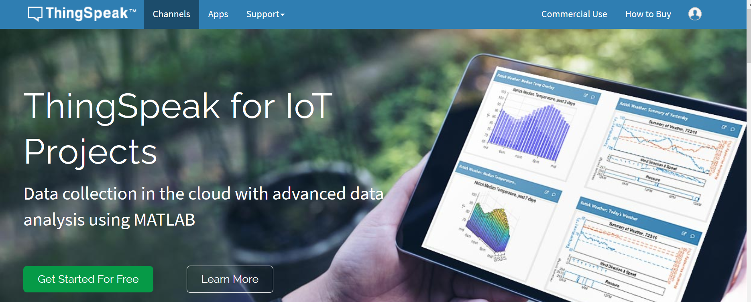
Configuring ThingSpeak to record Patient Data online:
ThingSpeak provides very good tool for IoT based projects. By using ThingSpeak site, we can monitor our data and control our system over the Internet, using the Channels and webpages provided by ThingSpeak.
ThingSpeak ‘Collects’ the data from the sensors, ‘Analyze and Visualize’ the data and ‘Acts’ by triggering a reaction.

Slide 15
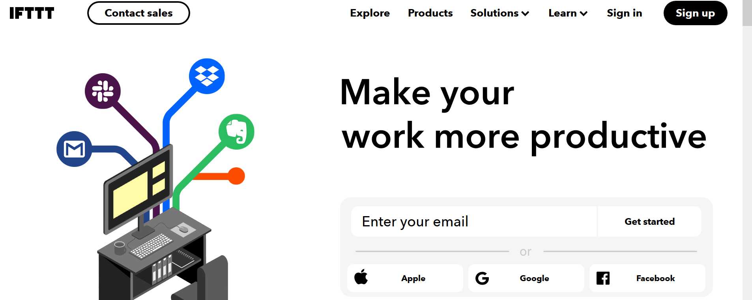
Configuring IFTTT for triggering Mail/SMS based on
ThingSpeak Values:
IFTTT is the free way to do more with hundreds of the apps and devices you love, including Twitter, Dropbox, Evernote, Nest, Fitbit, Amazon Alexa, and Google Assistant.
An applet is triggered by changes that occur within other web services such as Gmail, Facebook, Telegram, Instagram, or Pinterest.

Slide 16
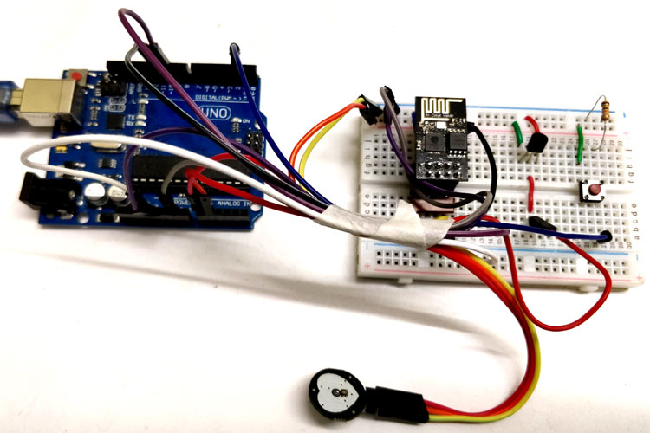
Patient Monitoring System in Action:
An applet is triggered by changes that occur within other web services such as Gmail, Facebook, Telegram, Instagram, or Pinterest.

Slide 17
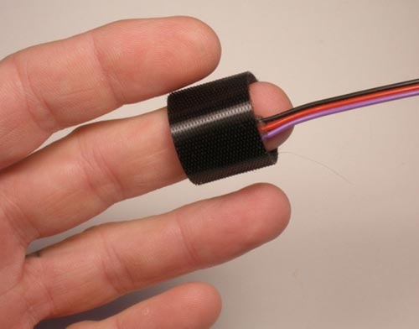
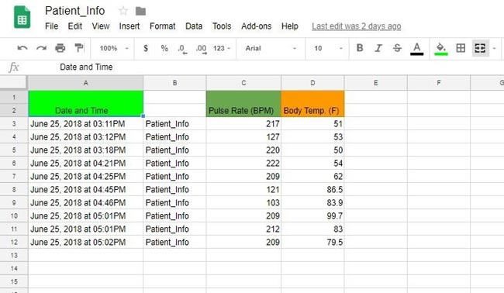
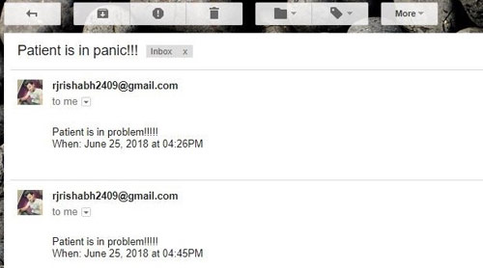
Results:

Slide 18
FUTURE WORKS:
The future work of the project is very essential in order to make the design system more advanced. In the designed system the enhancement would be connecting more sensors which measures various health parameters.
Add a GPS module in IoT based health monitoring system using Arduino and Wi-Fi module. The GPS module will find out the location or position of the patient using longitude or latitude received.
Then it will sent the location to the cloud using Internet Of Things and then doctors can find out the position of the patient in case they have to take some preventive action or nearest hospital will be informed automatically using GPS and ambulance will be sent to the patient. And establishing a Wi-Fi-mesh network will also increase the communication range.

Slide 19
THANK YOU

